Slide 1
ASTROSAGE
ANALYSIS
Project By : Thanneeru Pranay

Slide 2
ABOUT ASTROSAGE
AstroSage stands as a global powerhouse in the realm of Vedic astrology (Jyotish), providing a sophisticated ecosystem of digital tools, AI-driven insights, and expert services. Established in 2012 by visionary founder Arjun Mehta, the platform has consistently pushed the boundaries of the industry. As a pioneer in India's digital astrology sector, the company launched 'Mobile Kundi' in 2014. It has since established itself as a market leader in online matchmaking, astrology software, and live consultations, utilizing advanced technology to deliver precise cosmic insights to a global audience

Slide 3
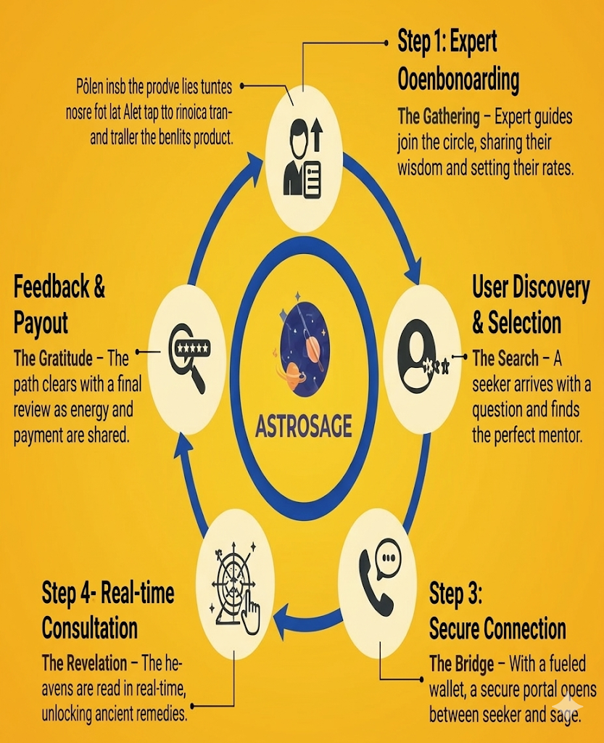
HOW ASTROSAGE WORKS
Step 1: The Gathering – Expert guides list their skills and shares, their wisdom and set their per minute consultation rates.
Step 2: The Search – A seeker arrives with a question and finds the perfect mentor among the top rated Gurus.
Step 3: The Bridge – the customers top up their wallets and can form a bridge between the guru either through call or secured chat.
Step 4: The Revelation – The kundlis are read in real-time, unlocking digital remedies, rituals to reduce problems or gemstones for improvement.
Step 5: The Gratitude – The path clears with a final review as the energy—and the payment—is shared.

Slide 4
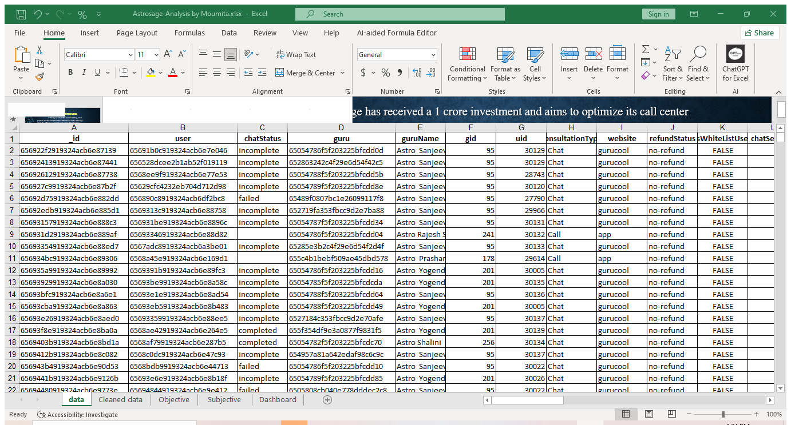
PROBLEM STATEMENT
Astrosage has received a 1 crore investment and aims to optimize its call center operations. The goal is to determine how to allocate this investment to maximize operational efficiency, customer satisfaction and profitability. The analysis will consider historical call data, performance metrics, and market trends to make informed decisions.

Slide 5
OBJECTIVE
To provide a complete data backed solution to improve revenue, customer satisfaction of Astrosage by implementing the different suggestions provided through data analysis.
Analyze the data set thoroughly, clean the data and find insights through pivot table and charts.
Share recommendations and future scopes to improve revenue and customer satisfaction through Data Analysis.

Slide 6
DATA CLEANING
Step 1: Explored – Collected the dataset and developed a comprehensive understanding of its structure and contents.
Step 2: Cleaned – Prepared the data by correcting inconsistencies, handling missing values with Excel functions, and formatting all fields for accuracy.
Step 3: Processed – Performed data transformations using formulas like COUNTIFS, LEFT, AVERAGE SUMIFS, pivot tables, and summary tools to distill the raw information into key metrics.
Step 4: Visualized – Built an interactive dashboard using tailored charts and slicers to make the aggregated data easy to navigate.
Step 5: Analyzed – Generated high-level insights from the dashboard, focusing on the specific fields that aligned with the project objectives.
Step 6: Recommended – Presented strategic improvement areas and data-driven suggestions to support the organization’s long-term growth.

Slide 7
KEY PERFORMANCE INDICATORS
28,027
Total Users: The platform has 28,027 active users engaging in consultations.
Total Astro Gurus: 131 astro gurus are actively providing services on the platform.
Total Revenue: Represents the overall revenue generated from all user consultations.
Astro Guru Earnings: Shows the portion of revenue earned by astro gurus
Operational Cost: Indicates the total cost incurred to operate the platform.
Average rating given by customers
131
213987
99146
114840
2.9

Slide 8
DAY WISE CALL VOLUME
Chart Description
This Line chart shows the call volumes in days taken in groups of 2
Actioned Recommendations
Staffing Adjustments: Personnel levels for Astro Gurus were increased during peak windows to minimize user drop-offs and address the high volume of incomplete calls.
Shift Optimization: A shift-based rotation was implemented to ensure higher agent availability during peak hours while reducing coverage during low-traffic periods to optimize costs.
Key Findings
Total Volume: The system processed a total of 8,508 calls during the reporting period.
Peak Activity: Peak traffic was recorded on 10 and 11 December 2023, with 430 and 424 calls respectively.

Slide 9
STATUS OF DIFFERENT CONSULTATION TYPES
Call Performance Analysis
Completion Rate: Completed calls accounted for the largest share at 40.55%, which reflected stable call handling processes during the period.
Operational Gaps: A significant portion of traffic—approximately 50%—consisted of busy, failed, or unanswered calls, highlighting critical gaps in availability and response capacity.
Strategic Recommendations
Optimized Resource Allocation: Agent availability and call routing protocols needed improvement during peak hours. Potential solutions included increasing staffing levels or implementing an auto-callback feature to mitigate busy and no-answer instances
Technical Resolution: A thorough investigation into technical redundancies was required to resolve network drops and system failures, thereby reducing call failure rates and improving the overall completion metric

Slide 10
REVENUE FROM EACH CONSULTATION TYPE
Net amount for different consultation types
The revenue generated for call is the maximum.
The revenue generated from services like public live call is 0
Strategic recommendation-
More investments are to be made to generate customer cunt for public live calls.
Investments need to be done to provide free complimentary services to active users to improve user footfall and to train new Gurus or Gurus with low ratings on a regular basis.

Slide 11
RATING BASED ON USER SATISFACTION
Unique user count by rating
The maximum amount of unique users rated less than 4.
Only a few users rated above 5.
The low ratings given by maximum number of user shows the lack of quality of services provided.
This depends on various factors like lack of infrastructure-calls not able to connect or inefficient call structures.
Strategic Recommendation
Heavy investments to improve training programmes .
Developing a regular feedback system to understand the issues faced by each user.
Heavy investments are needed to improve call center infrastructure.

Slide 12
TOP 10 GURUS AS PER THEIR AVERAGE RATINGS
Performance Summary-
Chat Performance
The Chat channel demonstrated strong results during the review period. Ratings for top performers ranged between 7.50 and 5.75. Specific individuals, including Pujaa Rai, Mystical, Swami G, and Vans, consistently delivered high-quality service. The overall chat experience achieved a solid average rating of 6.27, which indicated a high level of user satisfaction. Call Performance
The Call channel underperformed in comparison to Chat. Ratings were notably lower, falling between 5.0 and 4.3, with very few gurus exceeding the 5.0 mark. The overall call experience averaged 4.53, highlighting a significant need for operational improvements.
Strategic recommendation
Improve Call Quality Provide call communication training (voice clarity, confidence, call flow).Encourage shorter call handling time with structured responses. Review call recordings to identify common rating drop reasons.
Leverage Chat High Performers Use high-rated chat gurus to create:
  templates
  best-practice scripts
  response guidelines
  Assign new trainees to shadow top chat performers.

Slide 13
VOLUME OF CALL BY HOURS
Peak Morning Activity
Call volume reached its highest levels during the morning, specifically between 6 AM–8 AM and 9 AM–11 AM. This trend indicated that users preferred to initiate contact early in the day when their activity levels were highest.
Mid-Day Engagement
A secondary surge in volume occurred in the early afternoon, primarily from 12 PM–2 PM. This suggested that users engaged more frequently during lunch hours or mid-day breaks.
Off-Peak Trends
The lowest levels of activity were recorded during the late evening and late night, specifically between 9 PM–11 PM and 12 AM–2 AM. These figures indicated a minimal requirement for agent allocation during these off-peak periods.

Slide 14
CUSTOMER DISTRIBUTION BY WEBSITES
Analysis –
Most people use the gurucool website
Almost 1/3rd of the people rely on the app
Only 2 customers use the dashboards
Recommendation –
Investments need to be done to hire professionals to build a robust dashboards where customers can access all features with ease.
Regular maintenance and dynamic dashboards needs to be implemented using cloud programming to ensure the data values in dashboard changes according to time

Slide 15
GURU VS RATING
Analysis:
Maximum number of gurus falls within the 0-3 rating group
Very few percentage of the gurus are rated above 5.
-
Over 7000 Gurus in the 0 rating range shows the number of gurus that are completely inactive or face network issues while connection.
Hence investing in infrastructure is of outmost importance.
Around 13,000 gurus within the 1-3 rating shows they lack the quality of delivery and hence heavy investments need to be done on training as well.

Slide 16
ANALYSIS
This dashboard provided a comprehensive evaluation of Astro Stage’s consultancy operations between December 2023 and January 2024. The analysis tracked user engagement, service quality, and financial outcomes across 28,027 users and 131 astro gurus.
Operational Insights
Activity Patterns: The study identified peak demand periods, specifically between 6–8 AM, 9–11 AM, and 12–2 AM.
Service Delivery: Consultations were categorized by type (calls, chats, and public/complimentary sessions) and monitored for efficiency by tracking "busy," "failed," or "no-answer" statuses.
Platform Preference: Data showed that the vast majority of users accessed services via the mobile app, while the Gurukul platform saw minimal activity.
Performance and Revenue
Quality Control: User satisfaction was measured through rating distributions. Top-tier performance was noted from gurus such as Tarot Mythical and Astro Puja Rai.
Financial Metrics: The dashboard compared consultation volumes against financial health, specifically analyzing net revenue, guru earnings, and total operational costs.
Conclusion
By utilizing interactive slicers and diverse data visualizations, the dashboard allowed stakeholders to pinpoint demand trends and operational gaps. These insights were used to drive improvements in user experience and overall business efficiency.

Slide 17
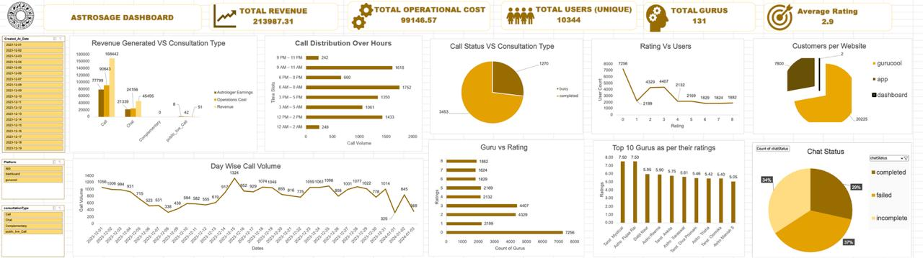
DASHBOARD

Slide 18
RECOMMENDATIONS
Technology & Automation (₹40 Lakhs | 40%)
Focus: Infrastructure Stability & Efficiency.
The Issue: Low completion rates (50.8% for calls, 16% for chats) due to system inefficiencies.
The Plan: Implement telephony backups, an integrated CRM, and AI-driven smart routing. These upgrades will reduce technical failures and maximize lead conversion.
2. Workforce Optimization (₹15 Lakhs | 15%)
Focus: Productivity & Load Management.
The Issue: High Guru count (131) but low output (2 calls/day) caused by peak-hour bottlenecks.
The Plan: Targeted hiring and optimized shift scheduling to align workforce availability with peak demand, ensuring higher completion rates.
3. Training & Quality Assurance (₹35 Lakhs | 35%)
Focus: Service Excellence & Skill Development.
The Issue: High dissatisfaction rate (72.5% rated 0–4) indicating significant service gaps.
The Plan: Launch a rigorous training program featuring peer mentorship from top performers and continuous quality audits to elevate the standard of service.

Slide 19
INVESTMENT GUIDELINES
. Customer Experience & Retention (₹10 Lakhs | 10%)
Focus: Loyalty & Lifetime Value.
The Issue: Risk of high churn due to incomplete sessions and poor ratings.
The Plan: Deploy loyalty programs, reactivation campaigns, and live engagement sessions to rebuild user trust and long-term retention.
5. Operational Priority: Strengthening Revenue Channels
Calls: Protect our primary revenue driver (79% of total) by resolving "busy" and "no-answer" status issues.
Chats: Unlock untapped potential in our high-volume chat channel by utilizing automation and specialized chat agents to address the current 84% N/A rate.
6. Performance Monitoring & ROI Tracking
We will implement a data-driven feedback loop to monitor call/chat completion and user ratings monthly. ROI evaluations at 1, 3, and 6 months will allow us to reallocate funds toward the highest-impact initiatives.

Slide 20
DATA OVERVIEW
The dataset contains customer consultation records, guru performance, revenue, and user ratings. After cleaning and preprocessing, the data was transformed into an interactive dashboard to uncover key business insights.

Slide 21

Conclusion
The analysis identified key opportunities to improve customer satisfaction, operational efficiency, and revenue through better infrastructure, workforce optimization, and quality training. These data-driven insights provide a clear roadmap for maximizing the impact of AstroSage's ₹1 crore investment.

Slide 22
THANK YOU

